Slide 1
Software
Mack 2021

Slide 2
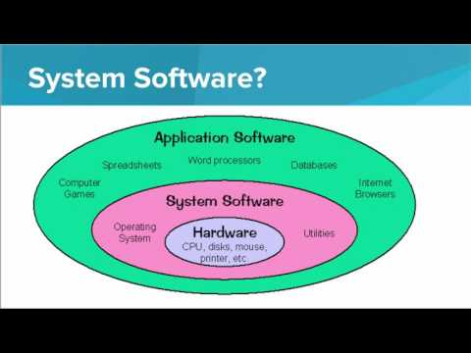
We learn about software, and the important programs and applications that make up most computer software.

Slide 3
Which of the following statements is something the operating system of a computer is responsible for doing?
Notes:
🍐 This is a Pear Deck Multiple Choice Slide. Your current options are: A: Managing memory allocation for all applications., B: Providing a way for the user to create text documents., C: Allowing the user to access the internet., D: Allowing the user to write programs.,
🍐 To edit the type of question or choices, go back to the "Ask Students a Question" in the Pear Deck sidebar.
A

Slide 4
Which of the following items is an example of a user application?
I. Browser
II. Text editor
III. Games
IV. File Explorer
Notes:
🍐 This is a Pear Deck Multiple Choice Slide. Your current options are: A: II, III, B: I, II, C: I, II, IV, D: I, II, III, IV,
🍐 To edit the type of question or choices, go back to the "Ask Students a Question" in the Pear Deck sidebar.
D

Slide 5
Software Explained
Read the following article and watch the embedded video to learn more about applications.
As you read, consider the following questions:
What are the different types of applications?
How do desktop applications and mobile applications differ?
Which category does the software discussed in this article fall into: user applications or system applications?
https://edu.gcfglobal.org/en/computerbasics/understanding-applications/1/
Want to learn more about softwware? Check out the following articles:
Computer Basics: Understanding Operating Systems
Basic Compter Skills: Free Software

Slide 6
Computer Applications You Use
List five computer software applications that you use regularly.

Slide 7
Operating Systems
Why does your computer need an operating system? List three to five reasons.

